Slide 1
Communication Tool
Team 3
CS673S17

Slide 2
Iteration 3
Previous vs Current System

Slide 3
Previous System - Features & Problems

Slide 4
Previous System - Features
Users can log into the web app using their username and password.
Users can create rooms and send messages from within rooms.
All users who are logged into the app are able to view all rooms and all messages.
The sidebar displays all rooms as well as the users that are currently logged in.
Users can upload files (bugged - only partially working)
Users can send emoticons in their messages.
Users can search for messages using a keyword or phrase. They will receive information about the messages that contain that keyword or phrase.
Working real-time chat via socket.io (WebSockets), integrated with Django and NodeJS

Slide 5
Previous System - Bugs & Problems
All rooms loaded into browser view context when navigating to a room
All messages for all rooms loaded into browser view context when navigating to a room.
Periodic duplication of messages when a user sends a message.
Unit tests & UI (Selenium) tests are run together; there is no segregation of unit and UI test suites.
Documentation for starting the web application was not accurate, and in some cases wrong.
URLs hard-coded throughout the codebase.
User-facing text and grammar contained numerous errors and was unprofessional.

Slide 6
Previous System - Bugs & Problems (continued)
Some unit tests & Selenium tests did not pass when the test suite was run.
No message limit applied to room messages.
Room upload functionality bugged and did not completely work.
API documentation did not exist.
ER Diagram for app did not exist
PYC files checked into the repo on github.
After failing to login in once (wrong username and/or password) users had to wait 60 seconds before being able to attempt logging in again.
No navigation to other tools from within the communication tool.
Codebase poorly documented in general and no automated documentation tools being used.

Slide 7
Current System - Features, Improvements, and Bug Fixes

Slide 8
Current System - Bug Squashed!
Duplicate message bug fixed.
Room upload functionality fixed.
Users no longer have to wait 60 seconds when failing to login once.
Users connected to the communication tool now properly display in user list.
Various console errors and small bugs fixed.
Fixed heading for rooms covering up messages at the top of the window.
Messages are now retrieved on room load.

Slide 9
Current System - Codebase Improvements
Unit tests & Selenium tests are now independent and runnable as separate test suites.
Unit tests now passing when running the test suite.
Hard-coded URLs fixed and removed.
Removed dependency of the “home” directory for building/installing the codebase.
Duplicate files and trees cleaned up.

Slide 10
Current System - New features & Improvements
Restful API structure implemented.
Team names are now editable.
Teams are now deletable from within the communication tool.
Navigation added from within the communication tool.
Stricter password requirements added during registration.
Registration restricted to users with BU email accounts.

Slide 11
Current System - New Features & Improvements
Spellcheck added to message input.
Updated the communication tool’s UI.
Message length limit added.
Message limit of 5,000 messages applied to rooms.
Chat window now scrolls to the newest message sent.
User-facing text cleaned up, grammar fixed and made more professional looking.

Slide 12
Process, Product & Lessons Learned

Slide 13
Communication Tool - Process
Initially, explore app and create user stories on Pivotal Tracker for things that should be fixed or could be improved upon.
Team members choose user stories they would like to work on, and checkout new feature branches for each user story to be completed.
Team members push their feature branches, which then get reviewed by other team members, and eventually merged with our development branch.
The development branch is then merged with master to be deployed.

Slide 14
Communication Tool - Product
The extensive bug fixes and new features mentioned above were implemented, but most importantly we have cleaned up the codebase and added clear documentation for many aspects of the communication tool.
New documentation will make it possible for the heirs of this project to have increased velocity and productivity when continuing to work and improve upon its current state.
New documentation will make it easier for future developers to quickly write and run unit tests.

Slide 15
Communication Tool - Lessons Learned
Documentation is key. Having good documentation for building, starting, and running the web application is essential, especially when picking up an existing project and attempting to maintain and improve upon it.

Slide 16
Requirement and Design

Slide 17
Requirements
Original Requirements
Requirements Not Implemented
User Stories:
Iteration 1
Iteration 2
Iteration 3

Slide 18
Original Requirements Pt. 1
Chat tool works without console errors.
Grammar and English usage of user-facing text is correct.
Refactor the REST API url structure
Require BU email to access Communication Tool.
Password requirements - at least 8 characters using at least one uppercase letter, one lowercase letter, and one number.
Users can invite other users to rooms and groups.

Slide 19
Original Requirements Pt. 2
Users receive notification of room/group invite.
Users can create groups within rooms and invite other users. Messages in those groups can be viewed by invited users.
Messages written to a room or group remain for a month unless the limit of 5,000 messages is reached. Then, the older ones will be deleted first.
The sidebar shows groups that users have been invited to - within the room that they’re in.
Create documentation that clearly defines all steps to install app

Slide 20
Original Requirements Pt. 3 (Team 2)
Allow the user to see other recent or online (currently active) users.
Private and public chats
Use commands to switch between rooms and set reminders

Slide 21
Iteration 1
Delete Old Messages
Password Requirements
Fix Site Grammar
Update Site Design
Bug Fixes:
General console errors in JavaScript (Syntax)
File Upload Error (Hard-coded path)
Selenium and Unit Test Bugs

Slide 22
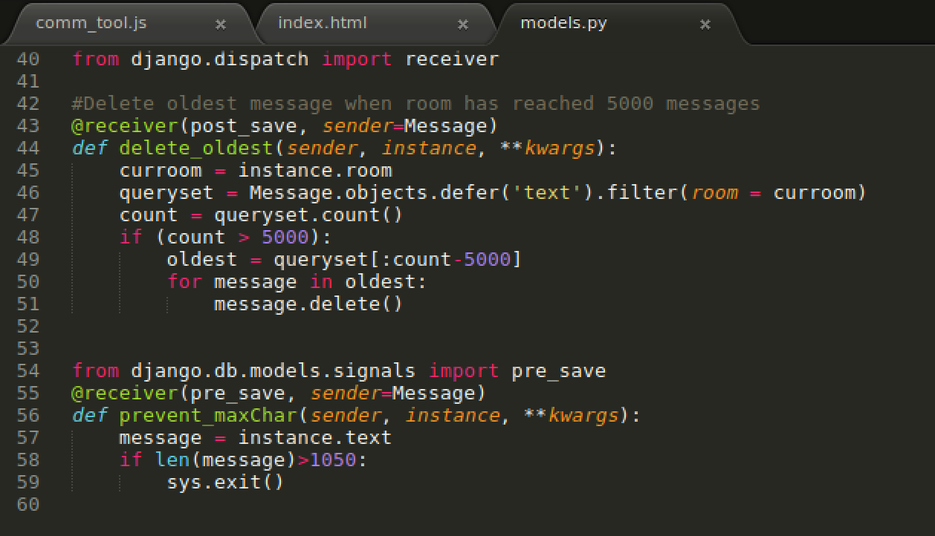
Delete Old Messages

Slide 23
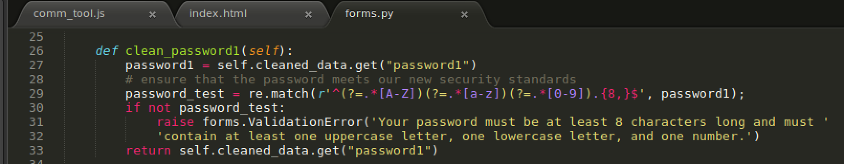
Password Requirements

Slide 24
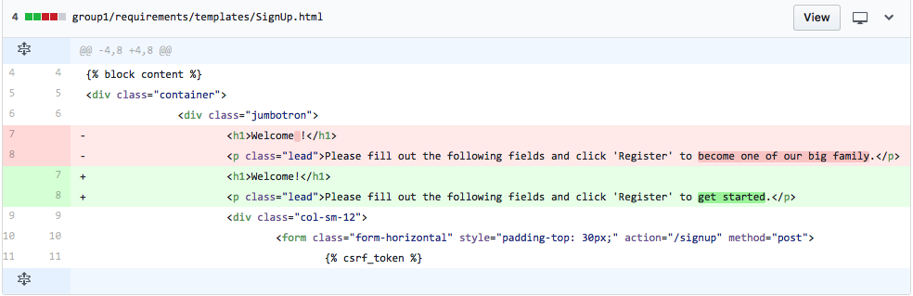
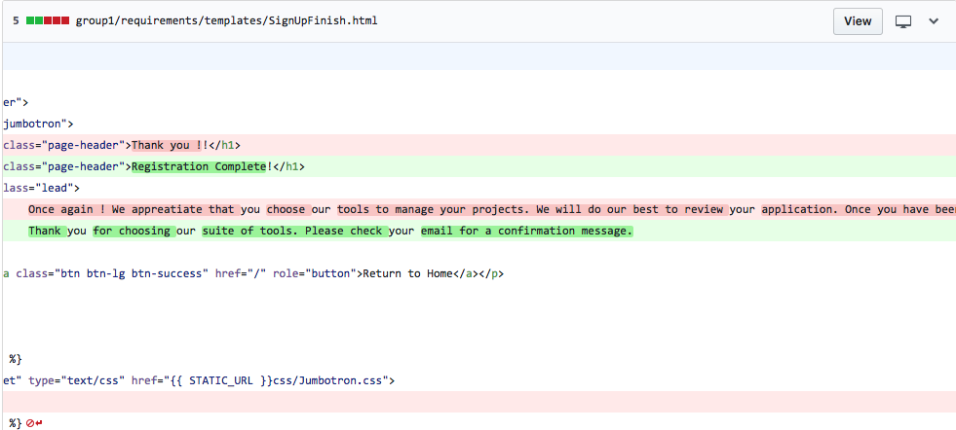
Fixed Site Grammar

Slide 25
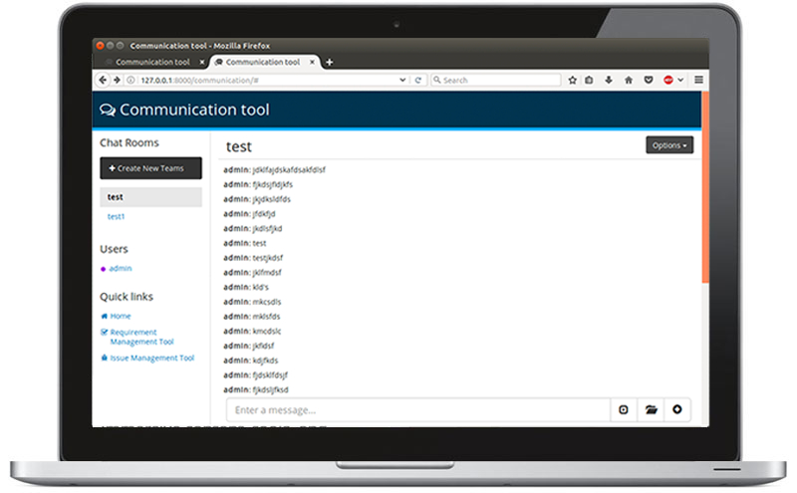
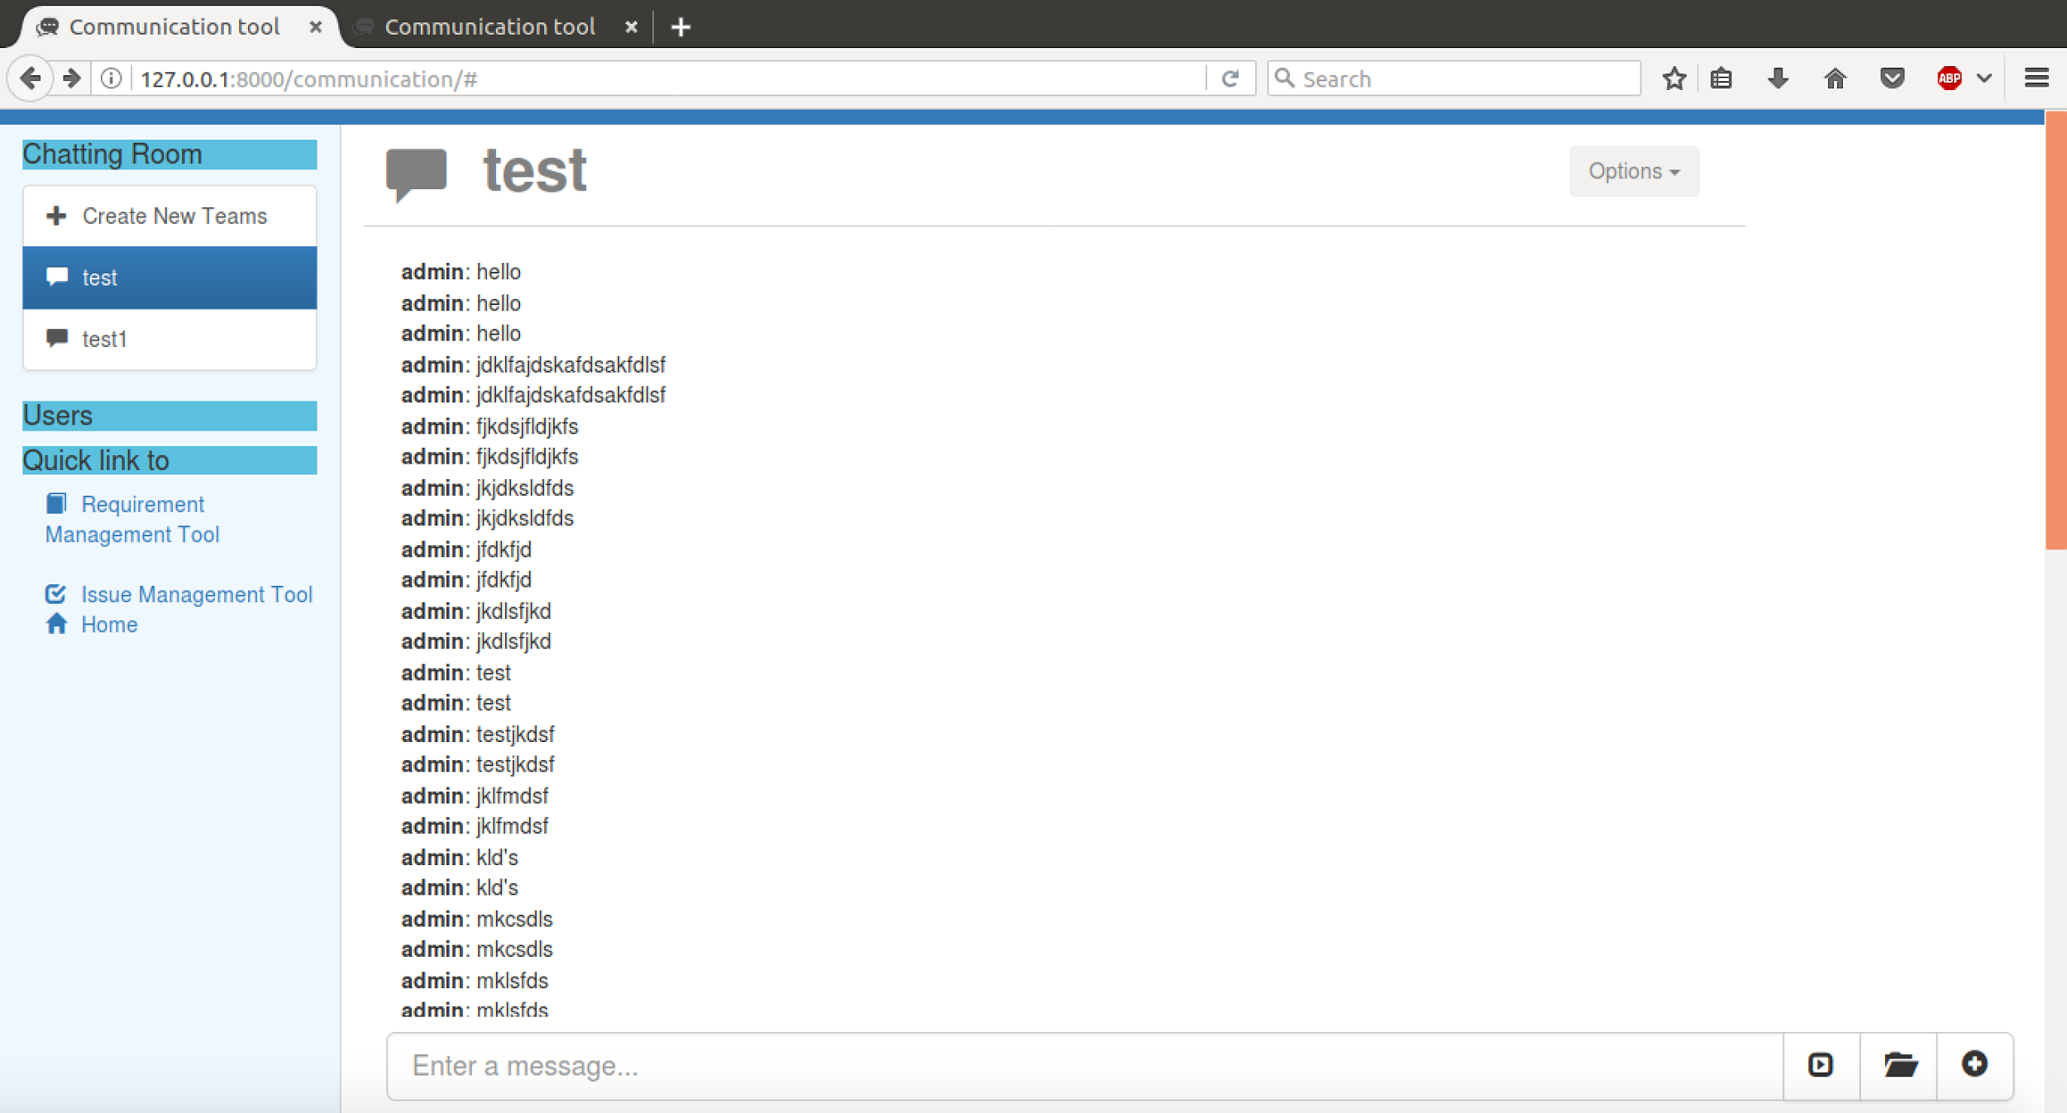
Update Site Design
Old design

Slide 26
Iteration 2
Edit Team Name (Generic modal, Node server updates record using API, creator field in Room model)
Delete Team
Limit Message Length
Create REST API Structure
Test Reorganization (Unit tests and Selenium in different folders)
Create Documentation

Slide 27
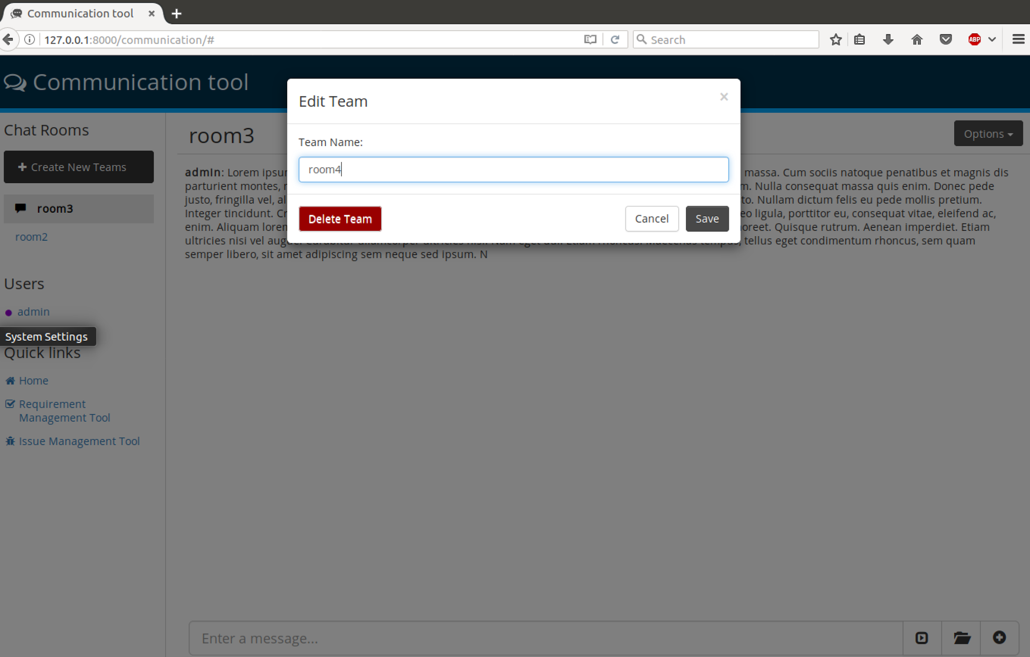
Edit and Delete Team Name
Notes:
(Generic modal, Node server updates record using API, creator field in Room model)
The team creator should have the ability to edit the name of the chat in case of an error or change
Tasks: Differentiate creator from non creator Add edit button from the options drop down menu Create Edit Team modal Create a method to update the value of the team in the database

Slide 28
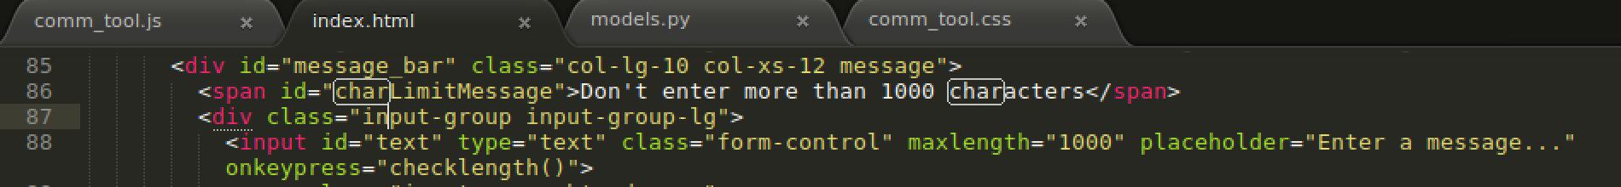
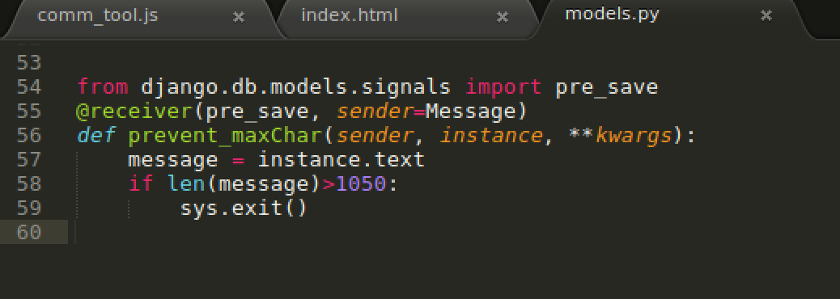
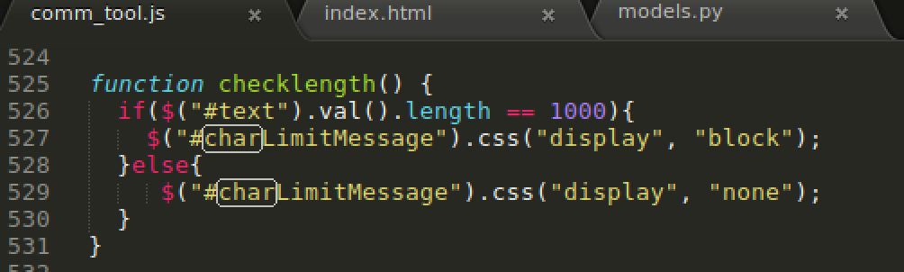
Limit Message Length

Slide 29
Refactored RestAPI
Unique room url
Each room now have different URL that needs appropriate permission to enter
This help with further implementation of private room/chat
Bookmarkable for invitation
Install requests for any room/user messages
Scalable

Slide 30
Test Reorganization
Unique room url
Each room now have different URL that needs appropriate permission to enter
This help with further implementation of private room/chat
Bookmarkable for invitation
Install requests for any room/user messages
Scalable

Slide 31
Requirements Not Implemented
Groups
Notifications
Private Rooms/Invitations
Password Reset

Slide 32
Iteration 3
Edit and Delete Messages
Restrict Account Creation to BU Email
Spellcheck Message Input
Loading Rooms use REST API
Deployment
Bug Fixes:
New Messages Appear Twice
Chat Window Does Not Scroll Down on Load or New Message
Unable to Login After Account Creation

Slide 33
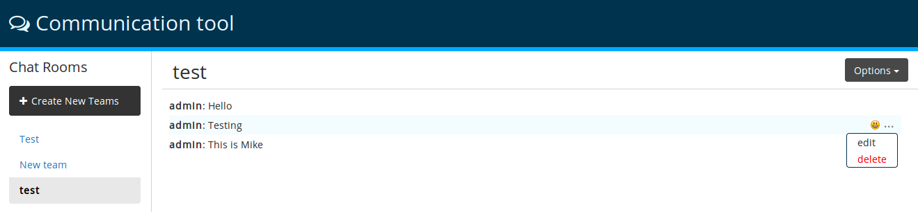
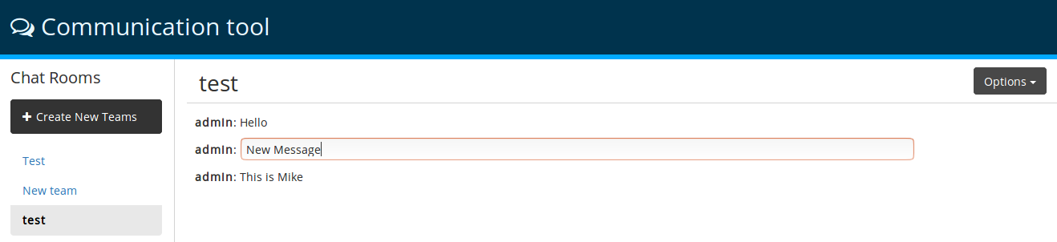
User Story: Edit and Delete Messages

Slide 34
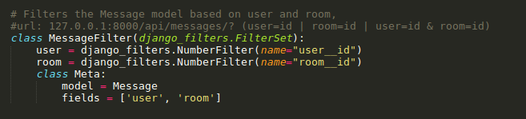
User Story: Load Room using Rest API

Slide 35
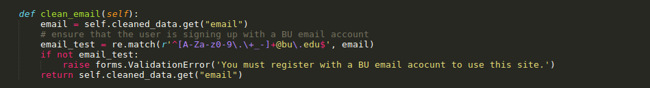
User Story: BU Email for Account Creation

Slide 36
Total
21 User stories completed

Slide 37
Design
Technologies
Architecture

Slide 38
Technologies
JavaScript
NodeJS
Django
SQLLite

Slide 39
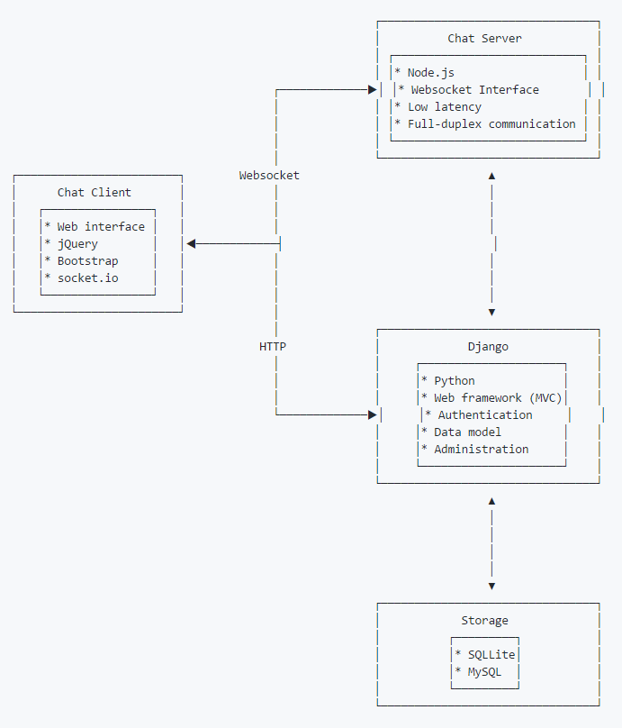
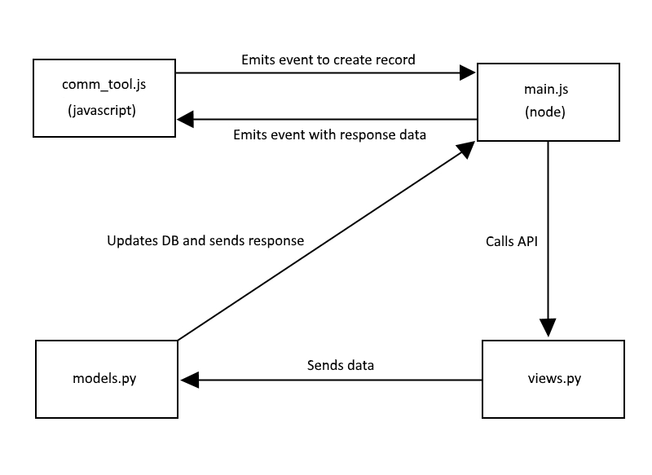
Architecture
Model - Template - View (MTV)

Slide 40
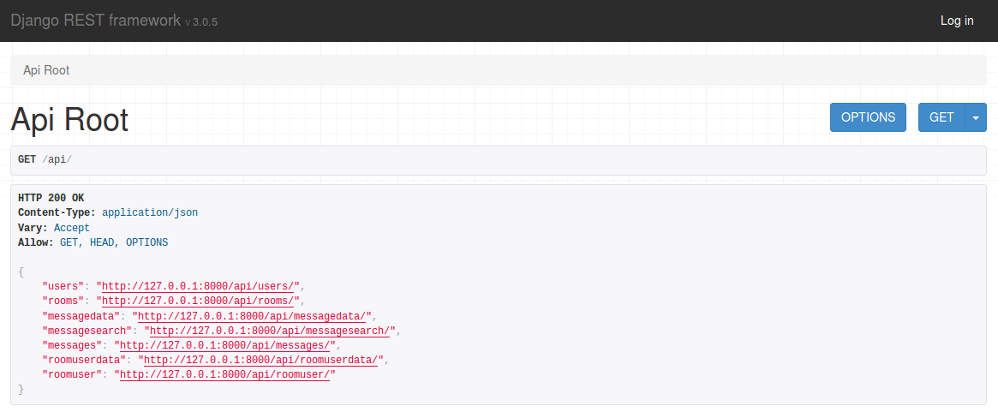
REST API

Slide 41
Implementation

Slide 42
Implementation tools and environment
Pivotal Tracker – user stories, issues/bugs
Virtual Machine – isolate environment/easier setup
VMware
Slack – group communication/private messaging
Git – version control
Documentation tools
Monodraw / Draw.io
Notes:
Used pivotal tracker for bugs, detail user stories, current features being worked on and upcoming features in the ice box
Decided to use a VM to isolate the environment/everyone has the same set up
Slack was used for private message, group messaging but also used for online standups.

Slide 43
Documentation
Django documentation via admindocs installed and enabled
Revised app build documentation with more concise django/node section
Revised API documentation
Entity Relationship Diagram (ERD)
File System Overview.
System Architecture Overview (including Chat Client Architecture)
Documentation for how to write and unit tests
Documentation for creating a “test” user
Notes:
Combined Django and Node section to make the documentation more concise and clear
Added documentation so able to setup with django admindocs documentation suite / revised the github instructions so users will be able to follow instructions and set up the system successfully (and also add the usage part so users can see if they actually set the system up successfully).
Added in architecture entity diagrams with control flow
Added in file system diagram with notes on important files
Wrote standards for code

Slide 44
Implementation Styles
Variable names descriptive and concise
Comments on all methods
Lines no longer than 100 characters
Braces always follow if statements
Files should have a header

Slide 45
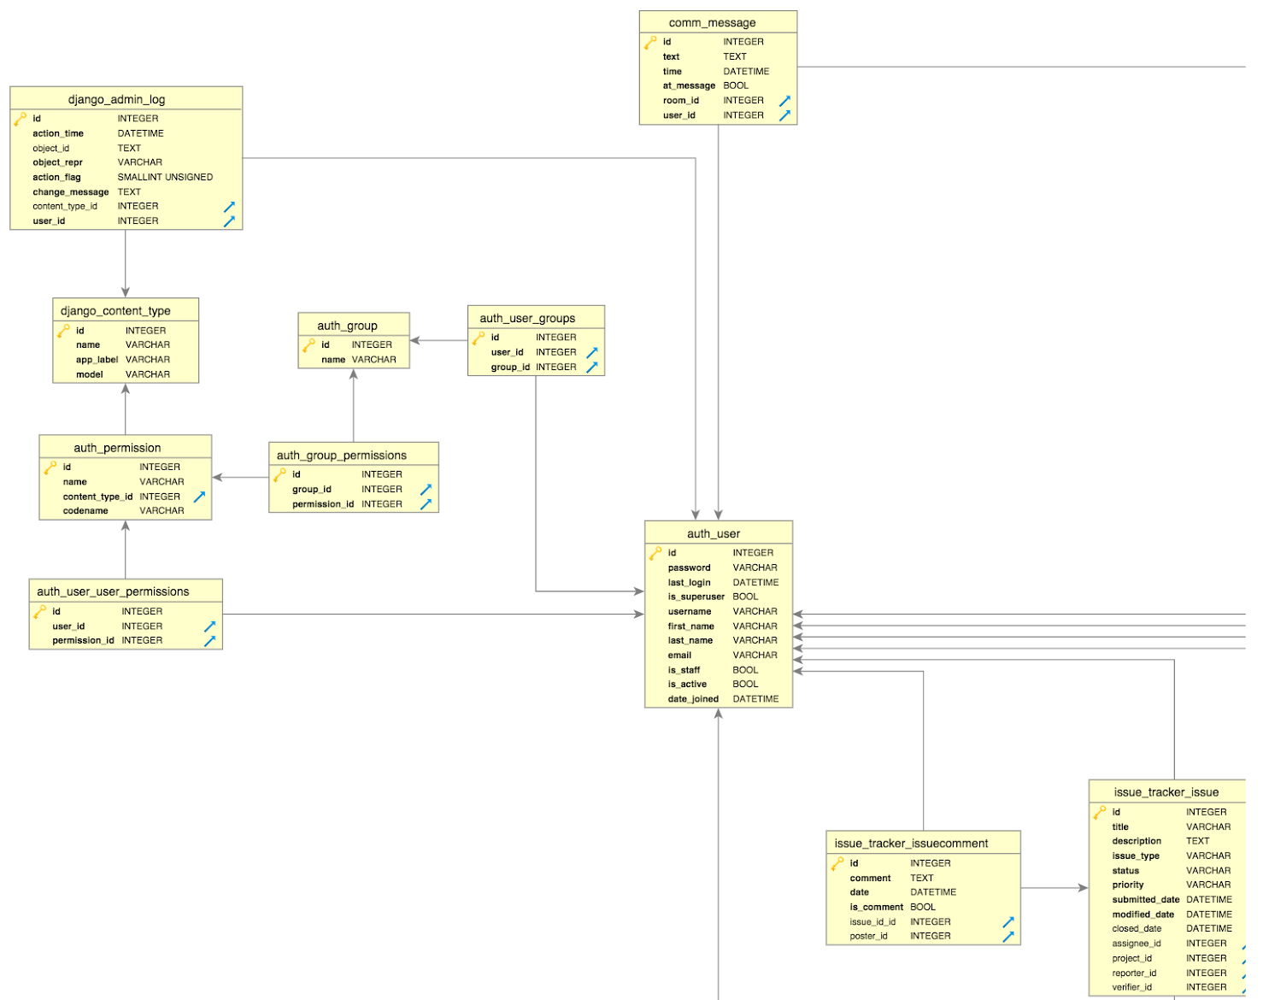
Entity Relationship
Diagram
Notes:
Cut off half; The whole diagram documents the full tool - issue tracker, requirement and communication tool, but zoomed in to focus on the comm tool
Entities and their relationship to each other

Slide 46
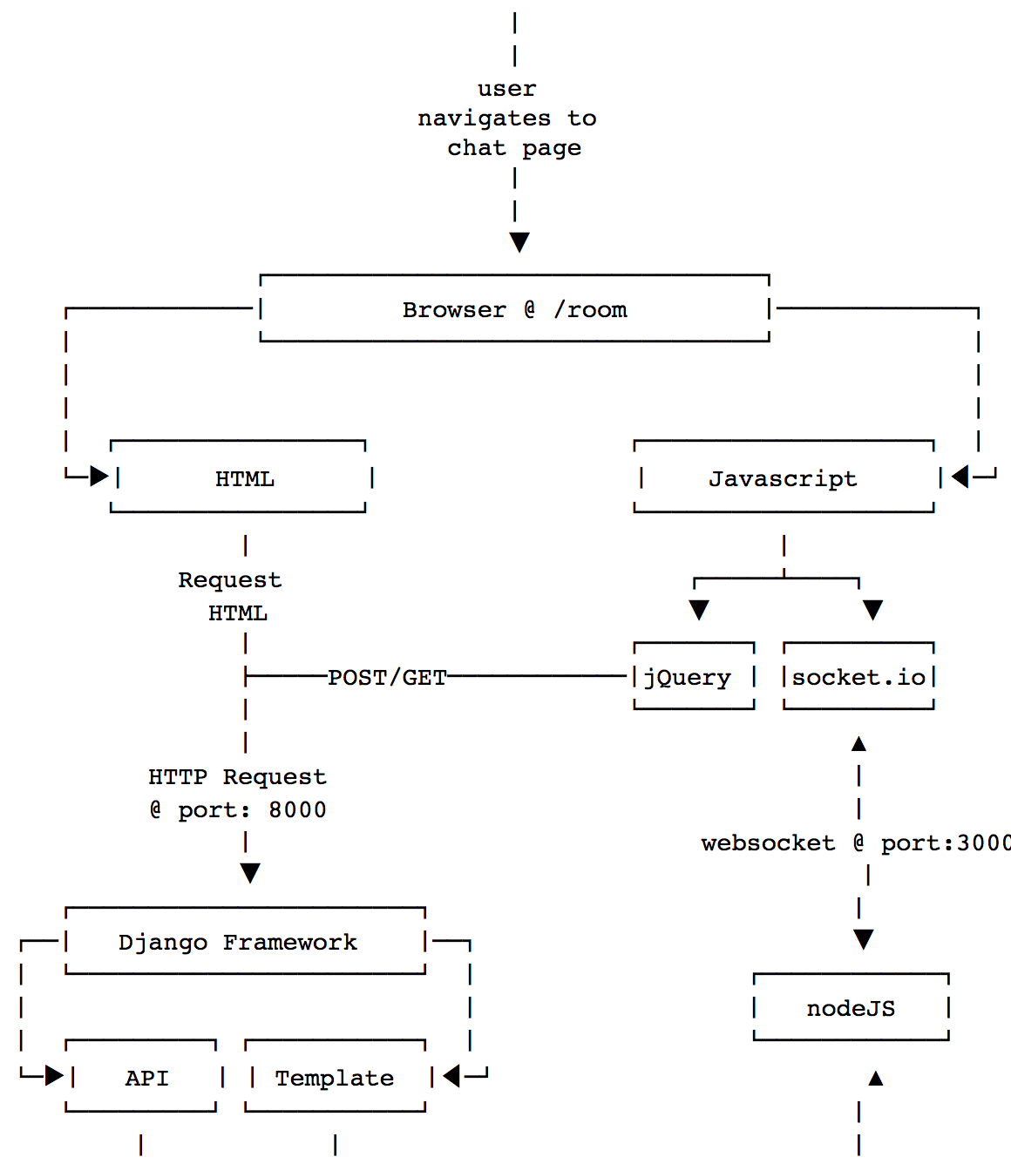
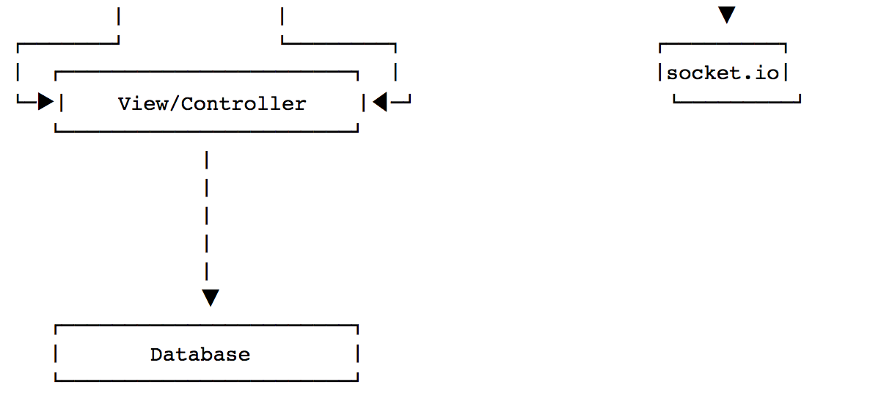
Chat Client Architecture

Slide 47
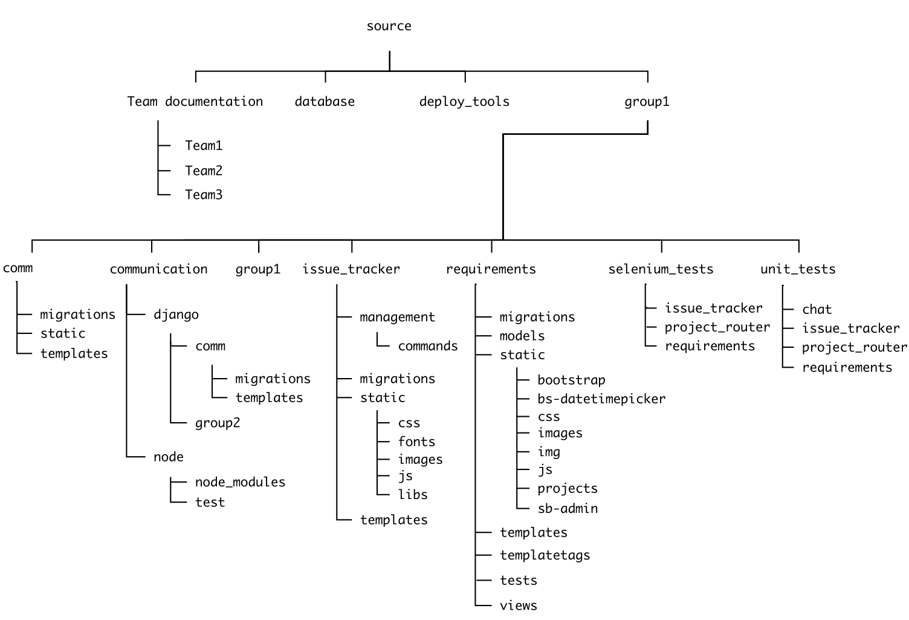
File System
Notes:
Added documentation so can easily see the file system organization.

Slide 48
Product/Quality of Implementation
Flexible/Efficient
More precise/thorough documentation to understand code
Test reorganization/cleanup – selenium and unit tests located in different directories under root
Renamed files and removed unnecessary tests
Scalable
Loading rooms use RestAPI – unique room url, appropriate permission to enter, allows for other features, bookmarkable
Higher degree of security
Account creation limited to BU email address
Notes:
Flexible & efficient – fixed and created new documentation for the app. The code itself is now more understandable, but also added architecture and ERD diagrams to understand the file structure and system.
Also reorganized tests - selenium and unit tests are now located in separate directions and located under the root directory rather than spread out throughout the tree. Files were renamed and unnecessary tests were removed (tests passing by default)
Scalable – refactored the chat rooms to now load using RestAPI. Each room now has a unique room url appropriate permission to enter. This allows for future features to be added that need to access specific chat rooms, they are now bookmarkable. Emails can direct to specific rooms for members with correct permissions.
Higher degree of security – the app now only allows users to create an account with a BU email address.

Slide 49
Lessons Learned
Start working on user stories early, especially if you have no clue what you're doing. It helps you learn the system.
Always add comments in the code.
Try to understand how other tools work and not just the app you're developing.
Pair programming usually works better than solo programming.
Communication is key with such a large team.
Working on an existing project is hard.

Slide 50
Project Management
Quidquid latine dictum sit, altum sonatur.
- Whatever is said in Latin sounds profound.

Slide 51
Management Structure
Old team configuration:
Team2: Niel
Team3: Oliver
New team configuration:
Team 3 Leader: Oliver
Team 3A: Ashu, Michael, Son
Team 3B: Mike, Emily, Albert
Team 3C - Will, Betsy

Slide 52

Management
Hold weekly meetings
Communicate with other team leaders
Make sure communication channel is open throughout the week
Ensure no one is blocked

Slide 53
Management (contd..)
Help team understand project architecture
Maintain code quality
Promote pair programming
Share memes

Slide 54
Process Improvement
Agile via weekly Scrum meetings.
Scrum meetings were ~15mins with answers to the following 3 questions:
What work has been completed?
What work remains?
Is the work progress blocked ?
Longer conversations (especially around “blocked” items) should occur after the ~15min meeting with the relevant people

Slide 55
Process Improvement (Continued)
At the beginning of every iteration there was a “retrospective” meeting. This was about figuring out what processes worked; what processes didn’t work; how could we improve; what issues came up.
The team voted on one “issue” from the retrospective that we would try to improve on for the next iteration.
At the end of every iteration, we had a demo of features by the team.
Towards the end of every iteration, the team revisited the user stories for the following iteration, based on the team’s progress and sprint velocity.
Code that was ready to be merged received an approved “Pull Request” via Github.

Slide 56
Things have changed
Before | After
Focus on fixing bugs | Focus on user stories
We have 3 bigger teams | Sub-team rocks
No SE knowledge | Design patterns, testings, refactoring

Slide 57

Achievements of Project
Small teams rocks!!!
Testing also rocks!!!
RestAPI is awesome!!! (It also rocks)
Balanced rocks

Slide 58
Quality Management and Metrics
Meme for life
- Son

Slide 59
Quality Management
Implementation Process
Code Review
Testing
Development Process
Retrospective Process Improvement
Management Process
Lower Communication Channels
Metrics
Risk Management

Slide 60
In-depth Metrics
Iteration Summary Metric
Iteration Comparison Metric

Slide 61
Script for Iteration Summary Metric
Help lower overhead of making metric
Make comparison metric much easier to create

Slide 62
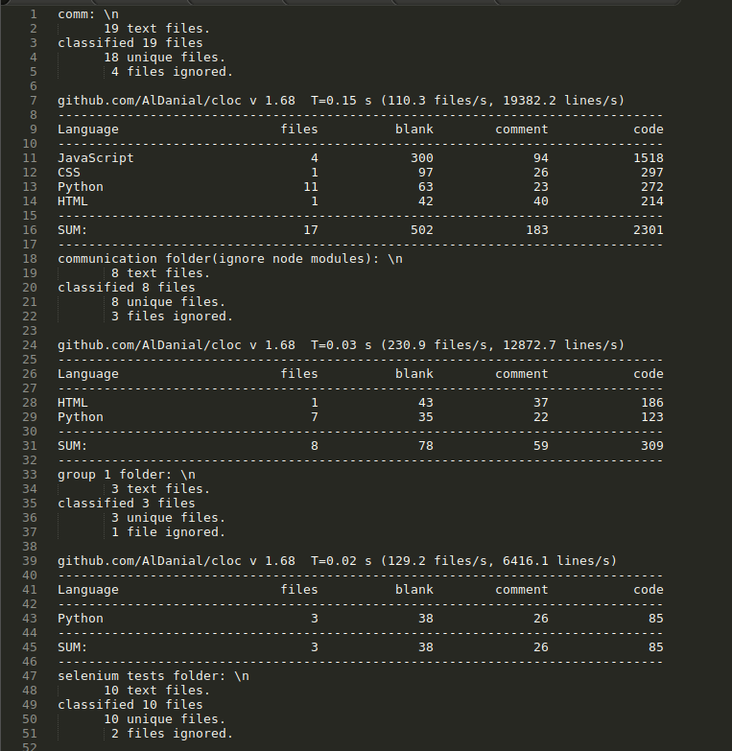
Iteration Summary Metric

Slide 63
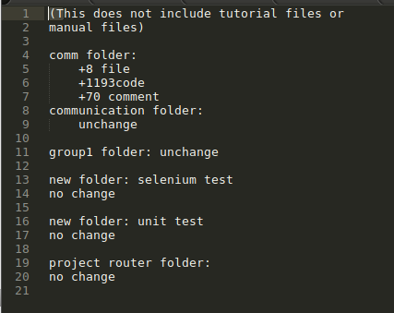
Comparison Metric

Slide 64
Requirement Metric
Number of user stories and points completed after each iterations
Help understand team’s velocity
Number of Bugs fixed / number of bug added

Slide 65
User Story and Bug Metrics
 | # Completed User Stories | # Bug Introduced | #Bug Fixed
Iteration 1 | 5 | 4 | 3
Iteration 2 | 8 | 0 | 0
Iteration 3 | 7 | 8 | 10
Total | 21 | 12 | 13

Slide 66
What Not Yet Included
Google Analytics for access and user analysis

Slide 67
Risk Management
never use decimals, binary or hex… use octal
- Michael

Slide 68
Risk Management
All projects involve a degree of risk. These are issues that can potentially cause problems such as a delay of the schedule or increased project costs.
We try to confront risks as soon as possible rather than waiting for them to confront us in the process of building the application.

Slide 69
Risk Management Model
Our risk management includes the following tasks:
Identify risks and their triggers
Classify and prioritize all risks
Craft a plan that links each risk to a mitigation
Monitor for risk triggers during the project
Implement the mitigating action if any risk materializes
Communicate risk status throughout project

Slide 70
Risk Management Model (Continued)
Our Monitoring includes:
Update SPPP reports and meeting minutes and include risk management issues
Revise risk plans according to any major changes in project schedule
Review and reprioritize risks, eliminating those with lowest probability

Slide 71
Risk Management Model (Continued)
Mitigating options include:
Accept: Acknowledge that a risk is impacting the project. Make an explicit decision to accept the risk without any changes to the project. Project management approval is mandatory here.
Avoid: Adjust project scope, schedule, or constraints to minimize the effects of the risk.
Control: Take action to minimize the impact or reduce the intensification of the risk.
Transfer: Implement an organizational shift in accountability, responsibility, or authority to other stakeholders that will accept the risk.
Continue Monitoring: Often suitable for low-impact risks, monitor the project environment for potentially increasing impact of the risk.

Slide 72
Identified Risks
RiskId | Risk | Probability | Impact | Action | Result
1 | None of us knew the required technology (Node & Django) | Frequent | Critical | Do tutorials. Scrum Meeting. Pair Programming. (Accept) | Risk mitigated significantly
2 | Someone dropped the class | Occasional | Critical | Change Management Pair Programming (Transfer) | Risk mitigated significantly
3 | Deep diving in the previous code | Frequent | Critical | File system and Infrastructure (Control) | Results are hard to evaluate

Slide 73
Identified Risks (Continued)
RiskId | Risk | Probability | Impact | Action | Result
4 | Merge Conflicts | Frequent | Critical | Pair Programming. Oliver did quadruple work. (Continue Monitoring) | Risk mitigated significantly
5 | Too much user stories to handle | Frequent | Marginal | Prioritization (Control, Avoid) | Risk still presented
6 | Team member missing scrum meetings | Occasional | Marginal | Extra meetings in sub-teams (Continue Monitoring) | Results are hard to evaluate

Slide 74
Other implementation to mitigate risks
Implementation | Risk mitigated
Documentations (SPPP, SDD, Meeting Minutes, Testing, Architecture Overview) | Responsibility and delegation Process monitoring
Sub-team meetings | Overriding works Schedule estimation
Iteration Presentation and Review | Process monitoring Schedule estimation

Slide 75
Final comments on risks
Not every risk can be dealt with earlier than its natural occurrence. However, we were doing proactive planning for our software project via risk management. The top-ranking risks were planned and mitigated. All risks were monitored. And it is important for us to focus on our project’s critical success factors while keeping an eye on its risk factors.

Slide 76
Testing & Deployment

Slide 77
Agenda
Testing
Process Overview
Evolution from pre-Iteration 01 → now
Lessons Learned
Deployment
Process Overview
Evolution from pre-Iteration 01 → now
Lessons Learned

Slide 78
Testing Process Overview
Unit Tests
Django
Selenium Tests
Django + nodejs
Manual Tests
Automated Tests are managed through Django.

Slide 79
The State of Testing, pre-Iteration 01
Documentation was non-existent
Tests were broken
Multiple errors across the testing layer
Test dependencies not installed
Gecko driver
Firefox browser
Missing Python packages
Tests tested code that did not exist
Stub tests that asserted True
Tests required test data installed in database

Slide 80
The State of Testing, Now
Test documentation included in repo
Split tests into isolated file trees
Unit tests can be run without integration tests
Selenium tests can be run without unit tests
All tests can be run at once
Bad tests have been deleted

Slide 81
Testing Metrics
# Tests: 65
Selenium: 11 (failures=1, errors=4),
Unit: 54 (failures=2, errors=4)
Test Pass Rate: 83% (failures=3, errors=8)
Coverage: 74%
KLOC (just chat tool): 3723

Slide 82
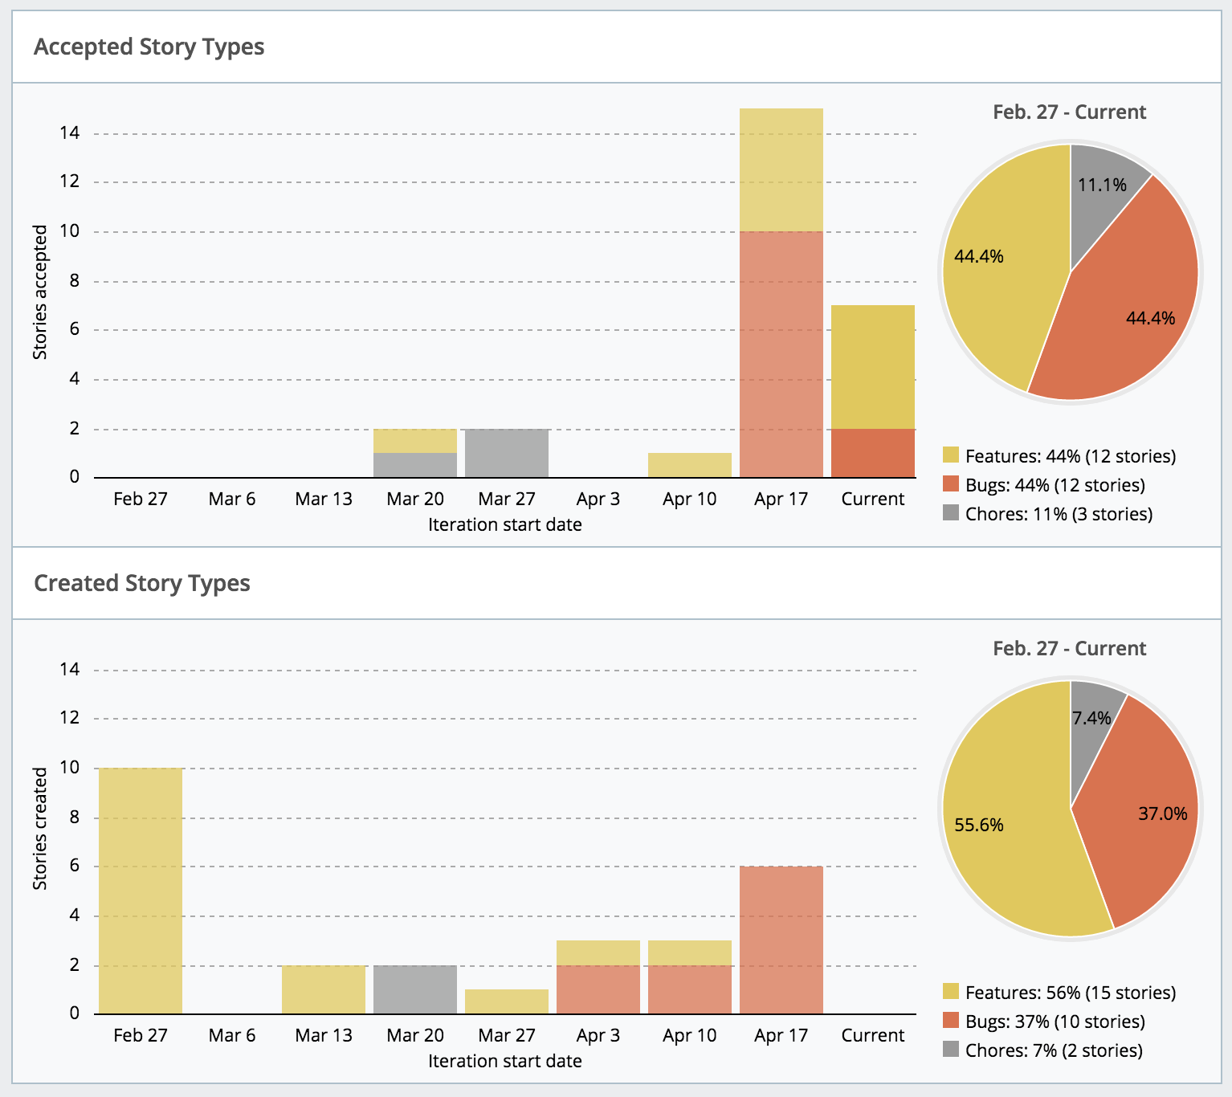
Testing, Defect Tracking

Slide 83
Testing, Lessons Learned
Huge learning curve for Selenium tests
Studying & Fixing the tests gave me good overview on how the application works
Nobody wants to QA when there is development to be done (this includes me)
Code deployed to production without being tested
Selenium tests are difficult to write, and hard to maintain against a living code-base
No Javascript unit tests increased risk of chat server development

Slide 84
Deployment Process Overview
What is difficult about deployment ?
Production arch is generally different from development arch
Repo Deploy Tools may or may not work
Documentation may or may not be accurate

Slide 85
The State of Deployment, pre-Iteration 01
Our process for deployment was non-existent
VM’s installed locally over networked servers
Built and distributed VM’s to normalize development
Included documentation for usage of deploy tools had incorrect or obsolete information

Slide 86
The State of Deployment, Now
Deployed to a “staging” server, in order to understand deployment pain points
AWS EC2 (Ubuntu AMI) + Security Groups
Spent time understanding the existing deployment tool resources
Updated documentation
Spent time understanding & auditing the current state of the production server
Updated documentation
Ran “safe” tests using the included deployment tools to assess their usefulness
Deployed latest to Production server

Slide 87
The State of Deployment, Now
Some issues:
Found out the code running in production was ~1 year old, from a personal repo of a student
Domain Name expired, redirecting to hosting provider
Not sure why (headless) Jenkins process is running on server

Slide 88
Deployment, Lessons Learned
Continuous Integration / Continuous Deployment would be nice
Run all tests on commit would help with QA
Since deployment is “git-based”; use AWS ElasticBeanstalk or Heroku
No need to manage app server
No need to manage data store
Deployment is basically one command

